Slide 1
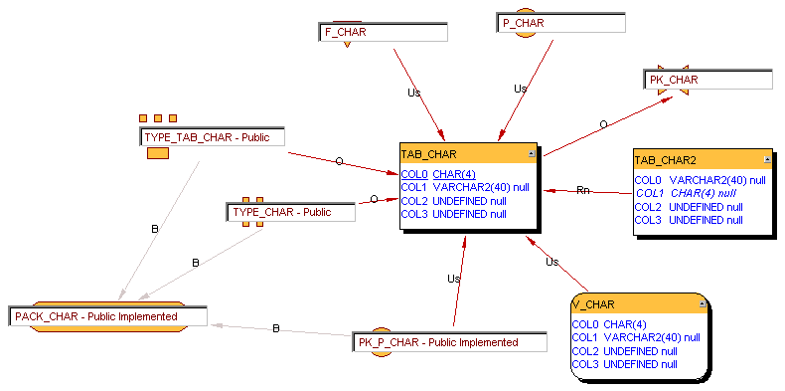
TAB_CHAR

Slide 2
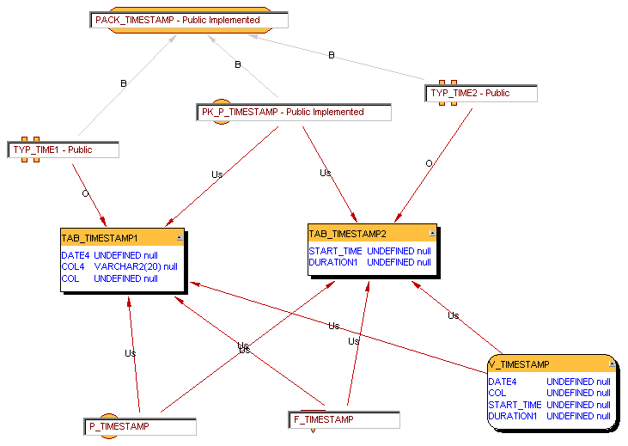
TAB_TIMESTAMP

Slide 3
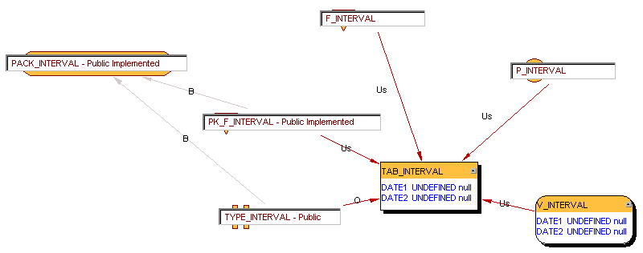
TAB_INTERVAL

